Slide 1
Cavitation Jet Direction Near Slot Geometries
Elijah Andrews
Ivo Peters
Notes:
Introduction…

Slide 2
Cavitation bubbles collapse
Bubble is effectively a sink.
Flow to bubble is impeded by the boundary.
Bubble collapses towards the boundary forming a jet.
Jet has many applications.
Water
Bubble

Slide 3
Cavitation bubbles collapse
Bubble is effectively a sink.
Flow to bubble is impeded by the boundary.
Bubble collapses towards the boundary forming a jet.
Jet has many applications.

Slide 4
Bubbles collapse towards boundaries
Bubble is effectively a sink.
Flow to bubble is impeded by the boundary.
Bubble collapses towards the boundary forming a jet.
Jet has many applications.
Water
Bubble
Boundary

Slide 5
Bubbles collapse towards boundaries
Bubble is effectively a sink.
Flow to bubble is impeded by the boundary.
Bubble collapses towards the boundary forming a jet.
Jet has many applications.

Slide 6
Experiment configuration

Slide 7
Collapse near a slot geometry
~1 mm
10,000x slower than real time

Slide 8
Collapse near a slot geometry

Slide 9
Slot parameters, normalized by width
Parameter definitions
Non-dimensional parameter definitions

Slide 10
Data from experiments
$w=2.2mm$ $h=2.7mm$ $q=3.84mm$
$w=4.2mm$ $h=11.5mm$ $q=2.43mm$

Slide 11
Boundary Element Method (BEM)
The boundary is represented as a series of sink panels.
No-through-flow is solved at each panel centroid.
Jet direction is the velocity at the bubble centre induced by the boundary sink panels.

Slide 12
Experimental data comparison to numerical model
$w=2.2mm$ $h=2.7mm$ $q=3.84mm$
$w=4.2mm$ $h=11.5mm$ $q=2.43mm$

Slide 13
Numerical model predictions for varying height

Slide 14
Variation of peak for varying height
Variation of peak jet angle, $θ_{j}^{⋆}$
Variation of peak jet angle position, ${\overline{p}}^{⋆}$

Slide 15
Numerical model predictions for varying vertical distance

Slide 16
Variation of peak for varying vertical distance
Variation of peak jet angle, $θ_{j}^{⋆}$
Variation of peak jet angle position, ${\overline{p}}^{⋆}$

Slide 17
Collapse of experimental data

Slide 18
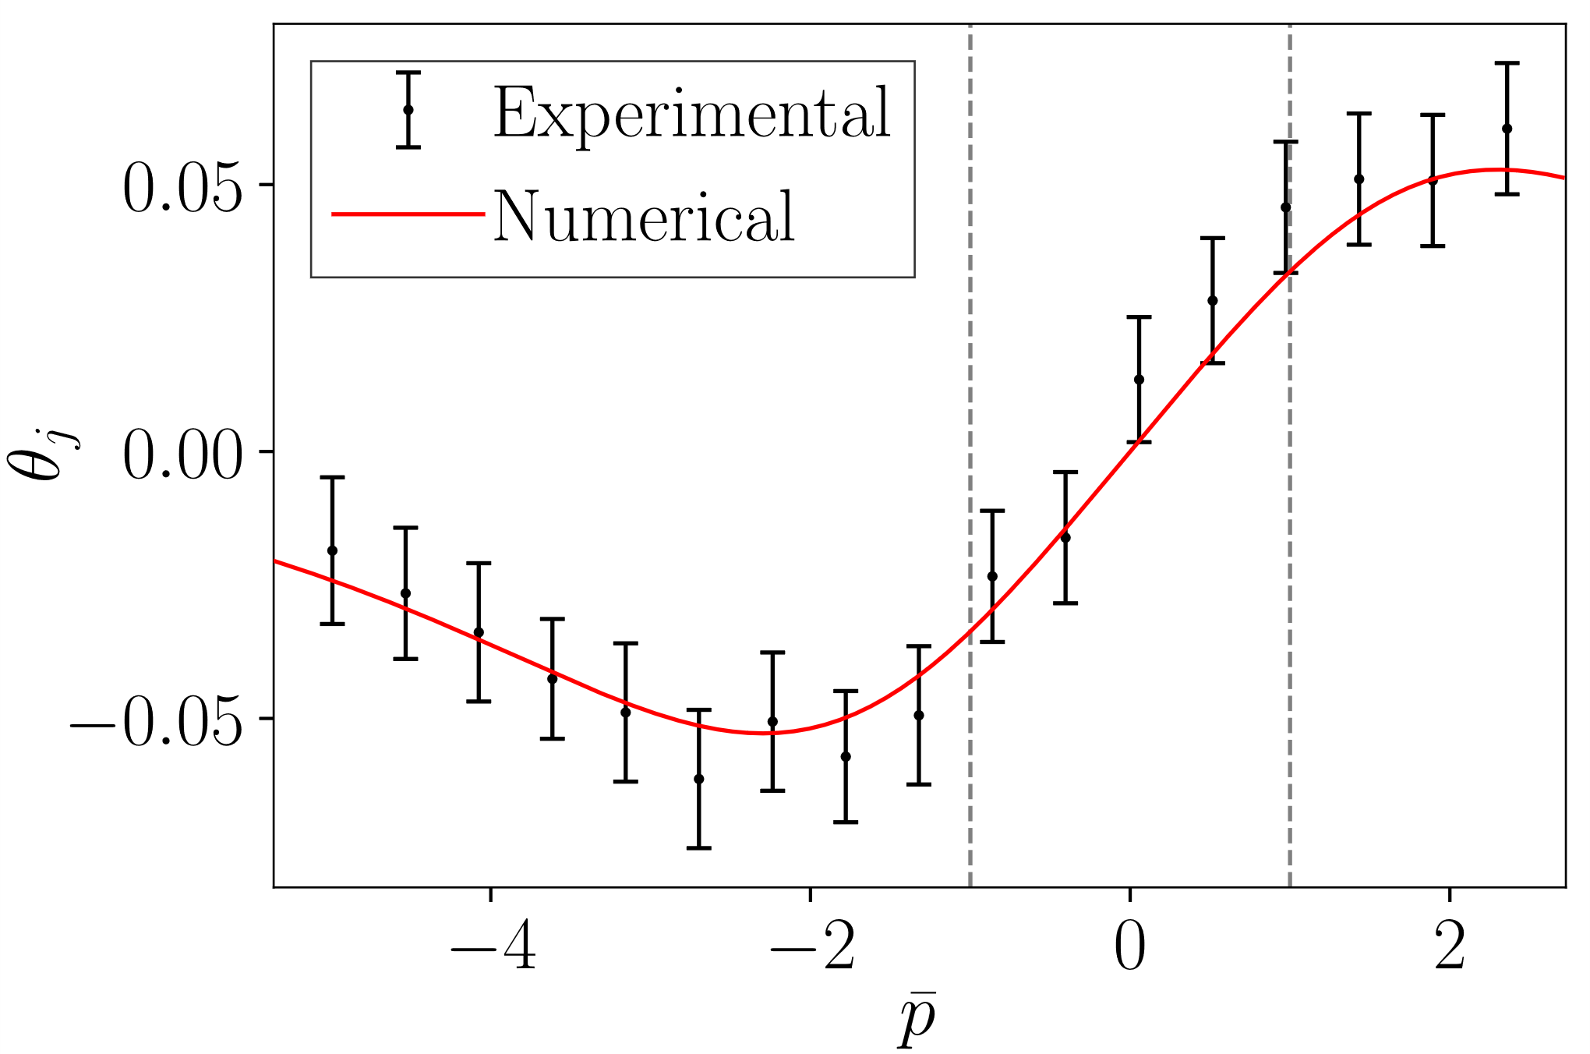
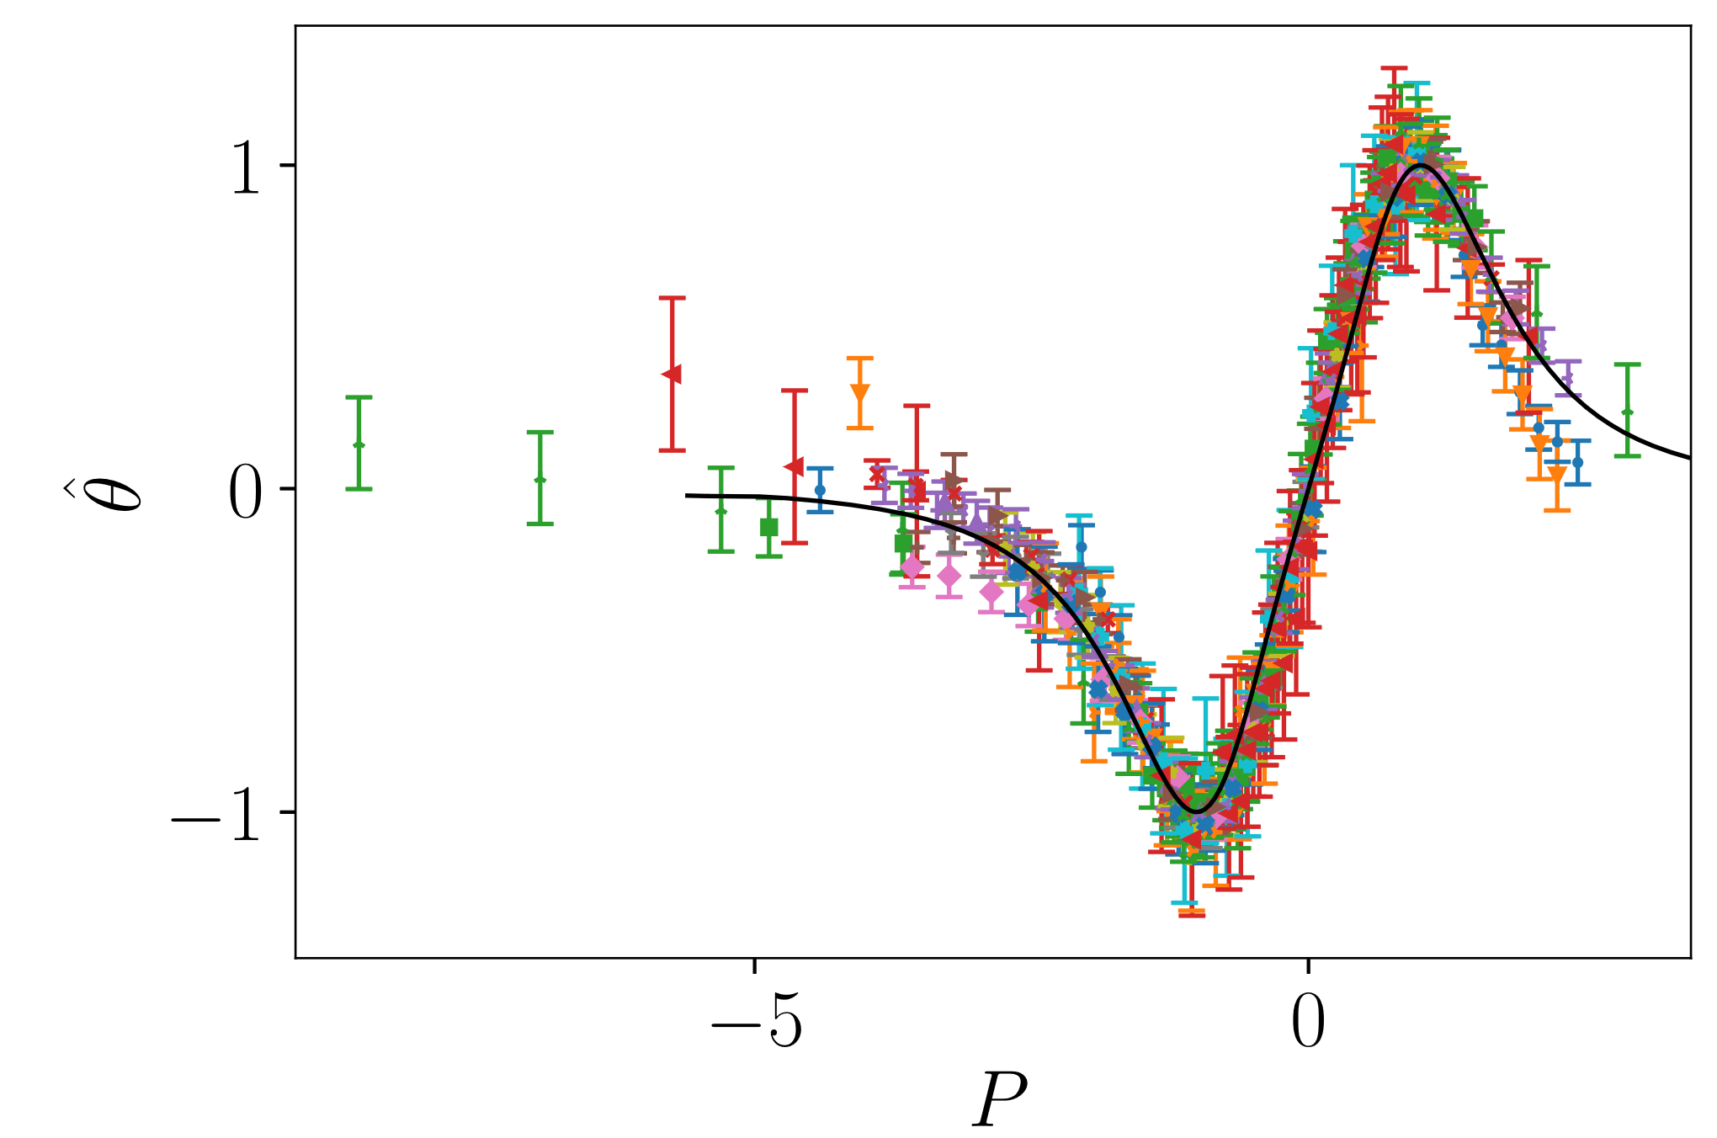
Summary
Performed experiments
Developed a simple numerical model
Numerical model agrees with experimental data
Jet direction only depends on $\frac{h}{w},\frac{q}{w},\frac{2p}{w}$ and collapses well
Elijah Andrews - e.d.andrews@soton.ac.uk

