Slide 1
How do bubbles collapse and displace near porous plates?
Elijah Andrews
David Fernández Rivas, Ivo Peters
Notes:
INTRO:
This talk is about...
I am… from Southampton University
With...

Slide 2
Cavitation bubbles collapse
Bubble is effectively a sink.
Flow to bubble is impeded by the boundary.
Bubble collapses towards the boundary forming a jet.
Jet has many applications.
Water
Bubble
Notes:
FUNDAMENTAL IDEAS:
- Usual explanation
- Remove part

Slide 3
Cavitation bubbles collapse
Bubble is effectively a sink.
Flow to bubble is impeded by the boundary.
Bubble collapses towards the boundary forming a jet.
Jet has many applications.
Notes:
FUNDAMENTAL IDEAS:
- Usual explanation
- Remove part

Slide 4
Bubbles collapse towards boundaries
Bubble is effectively a sink.
Flow to bubble is impeded by the boundary.
Bubble collapses towards the boundary forming a jet.
Jet has many applications.
Water
Bubble
Boundary
Notes:
FUNDAMENTAL IDEAS:
- Usual explanation
- Remove part

Slide 5
Bubbles collapse towards boundaries
Bubble is effectively a sink.
Flow to bubble is impeded by the boundary.
Bubble collapses towards the boundary forming a jet.
Jet has many applications.
Notes:
FUNDAMENTAL IDEAS:
- Usual explanation
- Remove part

Slide 6
Bubbles collapse towards boundaries
Bubble is effectively a sink.
Flow to bubble is impeded by the boundary.
Bubble collapses towards the boundary forming a jet.
Jet has many applications.
Water
Bubble
Boundary
Notes:
FUNDAMENTAL IDEAS:
- Usual explanation
- Remove part

Slide 7
What happens if part of the boundary is removed?
Bubble is effectively a sink.
Flow to bubble is impeded by the boundary.
Bubble collapses towards the boundary forming a jet.
Jet has many applications.
Water
Bubble
Boundary
Notes:
FUNDAMENTAL IDEAS:
- Usual explanation
- Remove part

Slide 8
What happens if part of the boundary is removed?
Bubble is effectively a sink.
Flow to bubble is impeded by the boundary.
Bubble collapses towards the boundary forming a jet.
Jet has many applications.
Water
Bubble
Boundary
Notes:
FUNDAMENTAL IDEAS:
- Usual explanation
- Remove part

Slide 9
What happens if part of the boundary is removed?
Bubble is effectively a sink.
Flow to bubble is impeded by the boundary.
Bubble collapses towards the boundary forming a jet.
Jet has many applications.
Notes:
FUNDAMENTAL IDEAS:
- Usual explanation
- Remove part

Slide 10
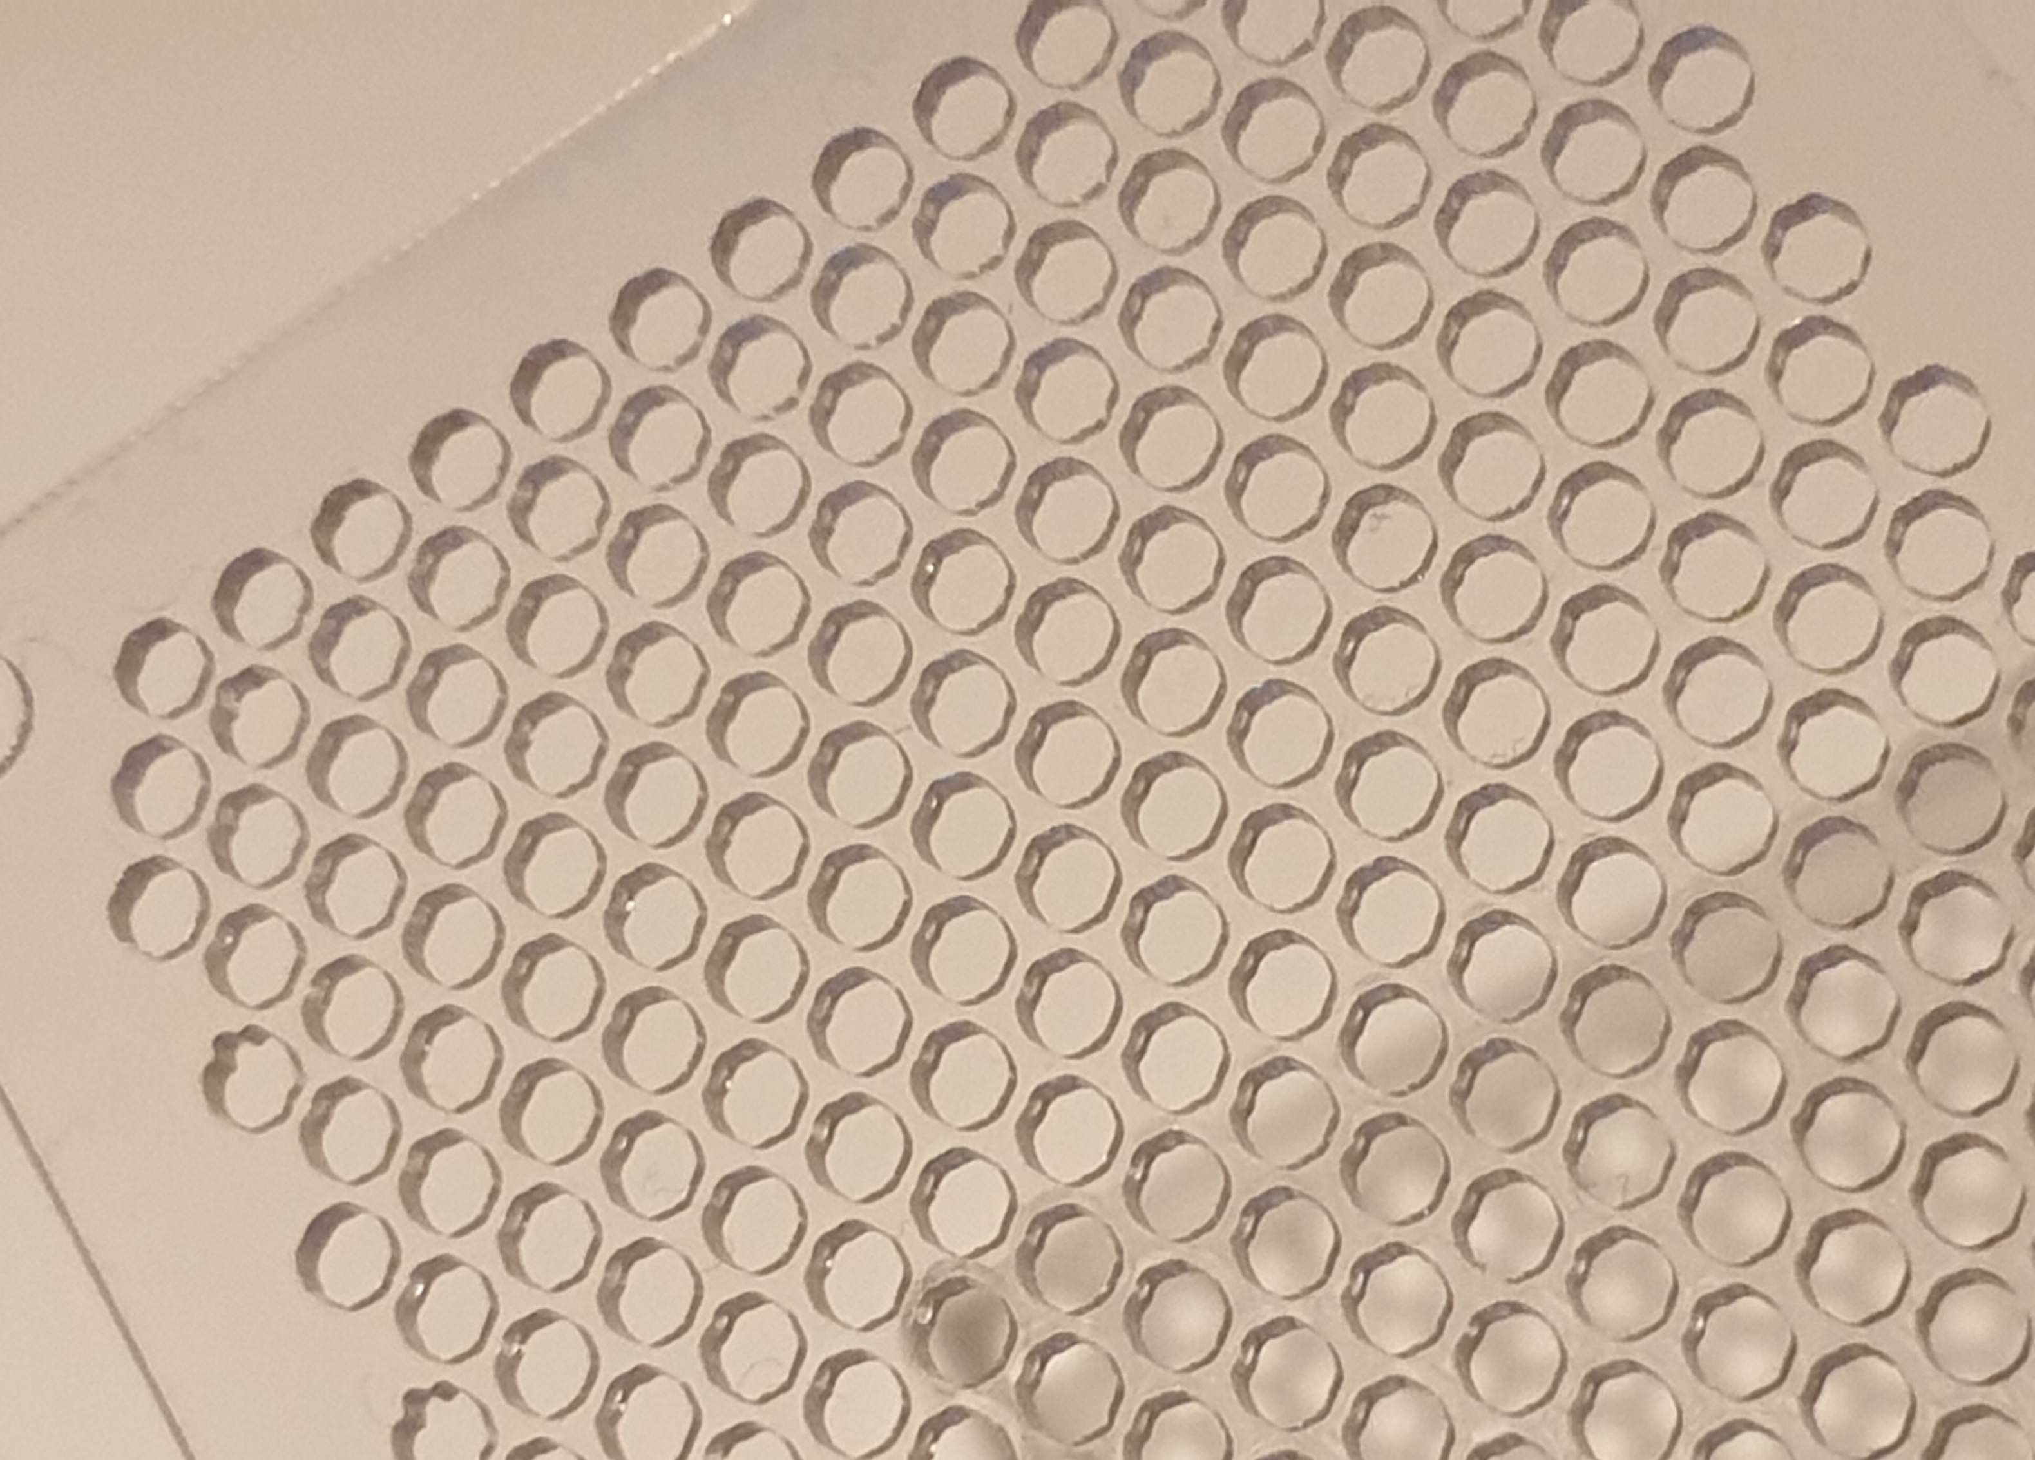
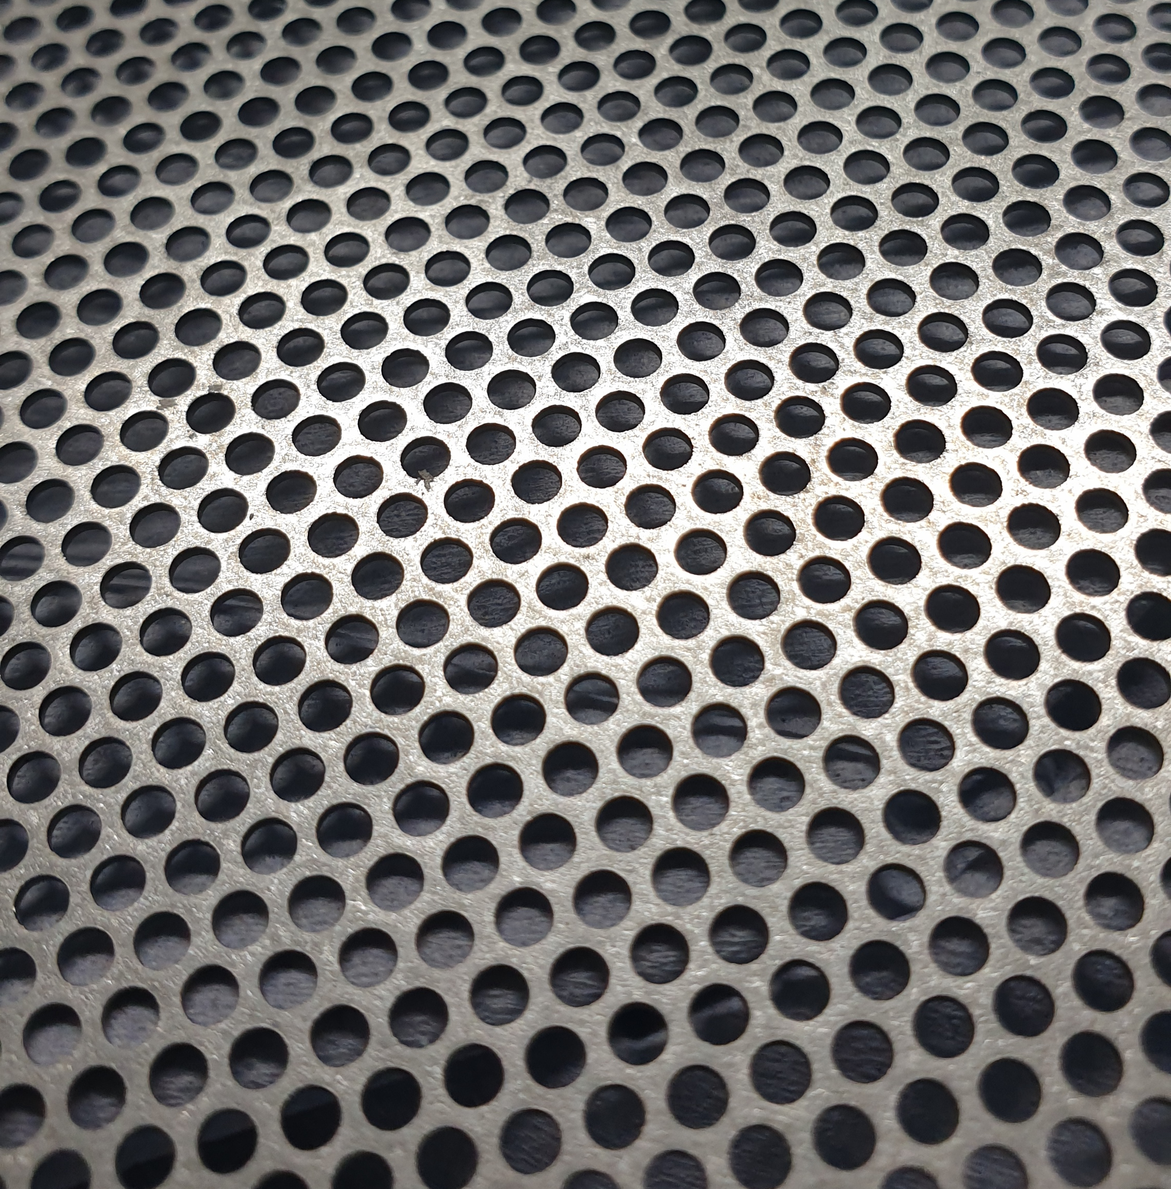
Example plates
Steel plate
Acrylic plate
Notes:
EXPERIMENTAL METHODS:
Practically we…
Plate examples
Talk through the diagram
Camera and backlight
Typical hole size

Slide 11
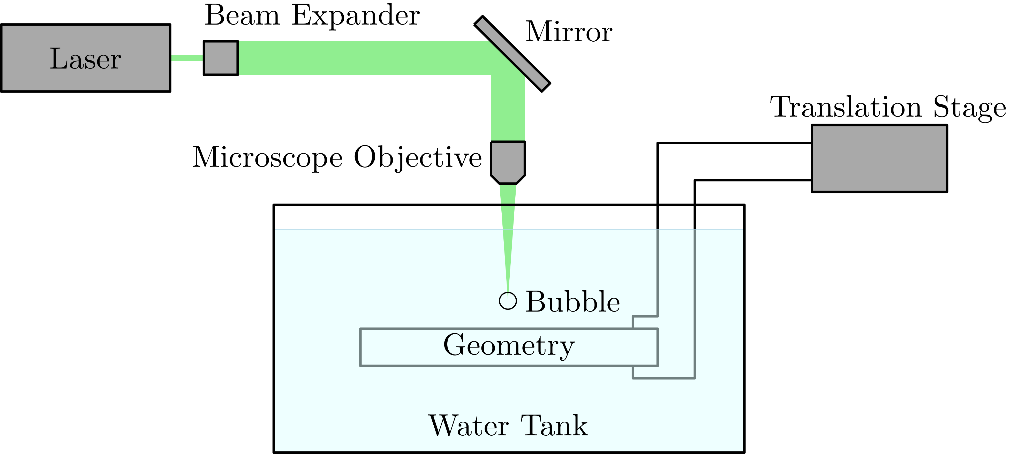
Experiment configuration
Notes:
EXPERIMENTAL METHODS:
- Plate examples
- Talk through the diagram
- Camera and backlight

Slide 12
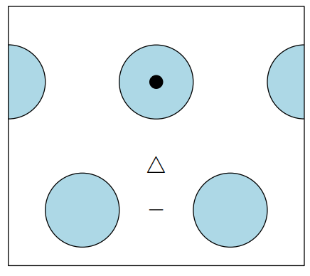
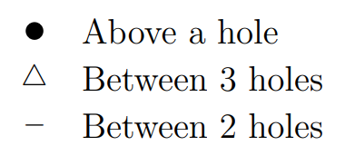
Typical bubble collapse video
Notes:
TYPICAL BUBBLE COLLAPSE VIDEO:
- Expand, collapse, expand, jet etc.
Timescale
Typical bubble size

Slide 13
Collapse above a hole
Notes:
COLLAPSE ABOVE A HOLE:
- Double jetting...

Slide 14
Collapse between 3 holes
Notes:
COLLAPSE BETWEEN HOLES:
- Preferential expansion...
- Splitting into three...

Slide 15
Collapse between 2 holes

Slide 16
Measurement of displacement
$$\frac{Δ}{R}$$
$$γ=\frac{Y}{R}$$
Notes:
MEASUREMENT OF DISPLACEMENT:
Want to characterise collapse [asymmetry/anisotropy]…
Measuring from maxima because slow...
Standoff parameter...
Typically, the greater the standoff...

Slide 17
Bubbles positioned over a hole
Notes:
HORIZONTAL POSITION:
- This is our typical plot of displacement as a function of standoff distance... we see the usual trend...
- Two extremes, most fluid vs most solid...
- Surprisingly, these plots show negligible difference between these positions...

Slide 18
Bubbles positioned between holes
Notes:
HORIZONTAL POSITION:
- This is our typical plot of displacement as a function of standoff distance... we see the usual trend...
- Two extremes, most fluid vs most solid...
- Surprisingly, these plots show negligible difference between these positions...

Slide 19
Bubbles positioned over a hole
Notes:
HORIZONTAL POSITION:
- This is our typical plot of displacement as a function of standoff distance... we see the usual trend...
- Two extremes, most fluid vs most solid...
- Surprisingly, these plots show negligible difference between these positions...

Slide 20
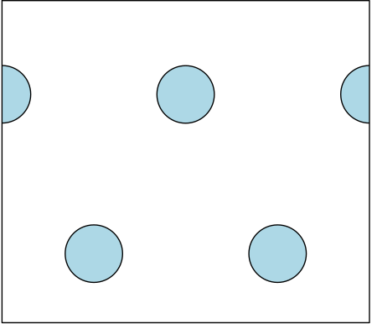
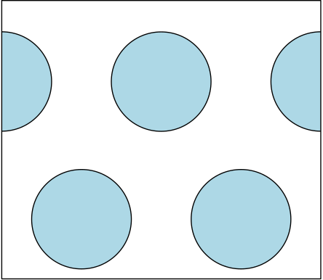
Changing void fraction
9% void fraction
36% void fraction
Notes:
VOID FRACTION:
- The void fraction is...
- We vary void fraction by changing the size of the holes...
- Starting with a solid plate and increasing the void fraction... reduced displacement...
- We can take cross-sections to visualise this change...

Slide 21
Displacement for different void fractions
Notes:
VOID FRACTION:
- The void fraction is...
- We vary void fraction by changing the size of the holes...
- Starting with a solid plate and increasing the void fraction... reduced displacement...
- We can take cross-sections to visualise this change...

Slide 22
Displacement for different void fractions
Notes:
VOID FRACTION:
- The void fraction is...
- We vary void fraction by changing the size of the holes...
- Starting with a solid plate and increasing the void fraction... reduced displacement...
- We can take cross-sections to visualise this change...

Slide 23
Displacement for different void fractions
Notes:
VOID FRACTION:
- The void fraction is...
- We vary void fraction by changing the size of the holes...
- Starting with a solid plate and increasing the void fraction... reduced displacement...
- We can take cross-sections to visualise this change...

Slide 24
Displacement for different void fractions
Notes:
VOID FRACTION:
- The void fraction is...
- We vary void fraction by changing the size of the holes...
- Starting with a solid plate and increasing the void fraction... reduced displacement...
- We can take cross-sections to visualise this change...

Slide 25
Displacement for different void fractions
Notes:
VOID FRACTION:
- The void fraction is...
- We vary void fraction by changing the size of the holes...
- Starting with a solid plate and increasing the void fraction... reduced displacement...
- We can take cross-sections to visualise this change...

Slide 26
Displacement for different void fractions
Notes:
VOID FRACTION:
- The void fraction is...
- We vary void fraction by changing the size of the holes...
- Starting with a solid plate and increasing the void fraction... reduced displacement...
- We can take cross-sections to visualise this change...

Slide 27
Displacement for different void fractions
Increasing $φ$
Notes:
VOID FRACTION:
- The void fraction is...
- We vary void fraction by changing the size of the holes...
- Starting with a solid plate and increasing the void fraction... reduced displacement...
- We can take cross-sections to visualise this change...

Slide 28
Displacement for different void fractions
Notes:
VOID FRACTION:
- The void fraction is...
- We vary void fraction by changing the size of the holes...
- Starting with a solid plate and increasing the void fraction... reduced displacement...
- We can take cross-sections to visualise this change...

Slide 29
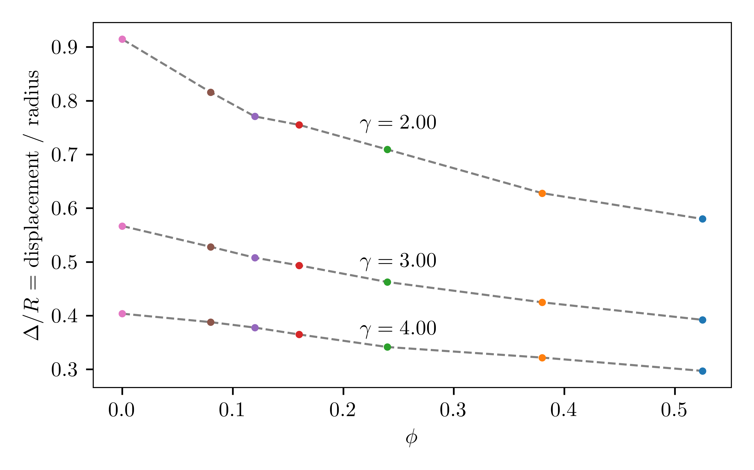
Displacement decreases as void fraction increases
Notes:
VOID FRACTION:
- The void fraction is...
- We vary void fraction by changing the size of the holes...
- Starting with a solid plate and increasing the void fraction... reduced displacement...
- We can take cross-sections to visualise this change...

Slide 30
What about flexibility?
Notes:
FLEXIBILITY:
One problem with these experiments is that the plates are slightly flexible...
Using a steel plate eliminates this flexibility but reveals an odd trend...
Very repeatable

Slide 31
Conclusions
Shown interesting dynamics of bubbles near porous boundaries
Horizontal position of the bubble has a negligible effect on displacement
Displacement decreases with increasing void fraction
Elijah Andrews - e.d.andrews@soton.ac.uk

Slide 32
Measurement of radius ratio
$$\frac{R_{max2}}{R_{max1}}$$
$$γ=\frac{Y}{R}$$
Notes:
MEASUREMENT OF DISPLACEMENT:
Want to characterise collapse [asymmetry/anisotropy]…
Measuring from maxima because slow...
Standoff parameter...
Typically, the greater the standoff...

Slide 33
Variation of radius ratio with void fraction

Slide 34
Geometric parameters

Slide 35
Effect of thickness
Notes:
High standoff distance – Makes sense
Low standoff distance – More complicated, not sure

