Slide 1
Low-cost modelling for bubble collapse displacement
Elijah Andrews
Ivo Peters

Slide 2
Cavitation bubbles collapse
Bubble is effectively a sink.
Flow to bubble is impeded by the boundary.
Bubble collapses towards the boundary forming a jet.
Jet has many applications.
Water
Bubble
Notes:
FUNDAMENTAL IDEAS:
- Usual explanation
- Remove part

Slide 3
Cavitation bubbles collapse
Bubble is effectively a sink.
Flow to bubble is impeded by the boundary.
Bubble collapses towards the boundary forming a jet.
Jet has many applications.
Notes:
FUNDAMENTAL IDEAS:
- Usual explanation
- Remove part

Slide 4
Bubbles collapse towards boundaries
Bubble is effectively a sink.
Flow to bubble is impeded by the boundary.
Bubble collapses towards the boundary forming a jet.
Jet has many applications.
Water
Bubble
Boundary
Notes:
FUNDAMENTAL IDEAS:
- Usual explanation
- Remove part

Slide 5
Bubbles collapse towards boundaries
Bubble is effectively a sink.
Flow to bubble is impeded by the boundary.
Bubble collapses towards the boundary forming a jet.
Jet has many applications.
Notes:
FUNDAMENTAL IDEAS:
- Usual explanation
- Remove part

Slide 6
Laser-induced cavitation

Slide 7
Bubbles collapsing near a flat plate
1 mm

Slide 8
A very simple mirror sink model

Slide 9
Splitting the sink into many

Slide 10
Splitting the sink into many

Slide 11
Splitting the sink into many

Slide 12
Modelling complex geometries

Slide 13
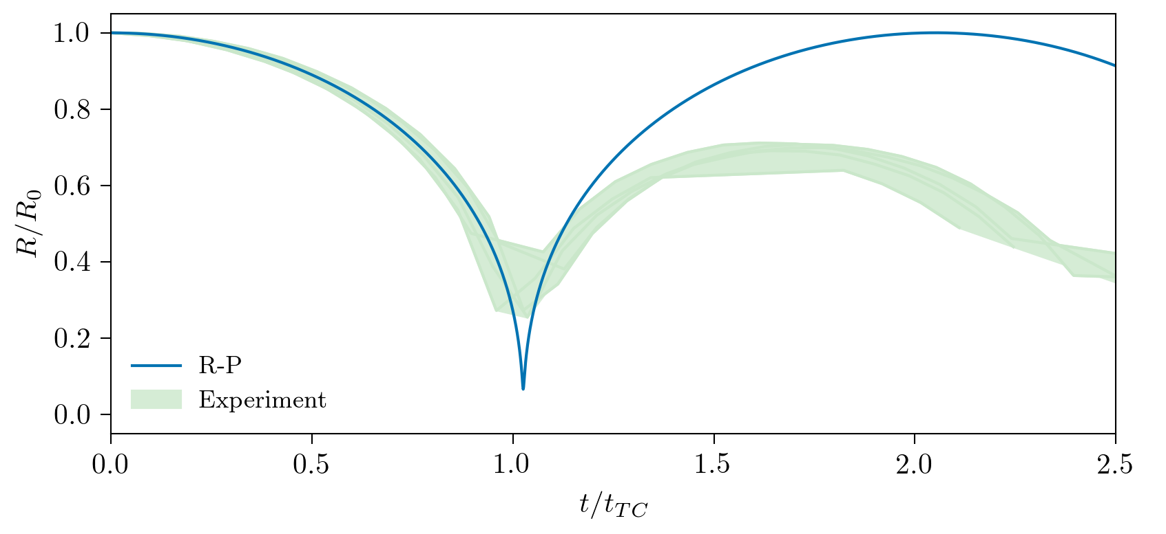
The Rayleigh-Plesset equation

Slide 14
Boundary Element Method (BEM)

Slide 15
Boundary Element Method (BEM)
Kelvin impulse $I= \int{Fdt}$
Anisotropy $ζ=\frac{I}{4.789R_{0}^{3}\sqrt{Δpρ}}$
$R_{0}=1.5$ mm
$Y=4.5$ mm

Slide 16
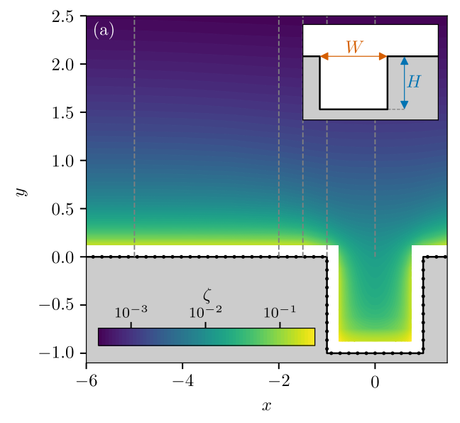
Slot anisotropy map

Slide 17
Other anisotropy maps

Slide 18
Lots of different bubbles and geometries

Slide 19
The same movies normalised

Slide 20
Analysing the bubbles
$$\frac{Δ}{R_{0}}$$
Notes:
MEASUREMENT OF DISPLACEMENT:
Want to characterise collapse [asymmetry/anisotropy]…
Measuring from maxima because slow...
Standoff parameter...
Typically, the greater the standoff...

Slide 21
All data collapses!

Slide 22
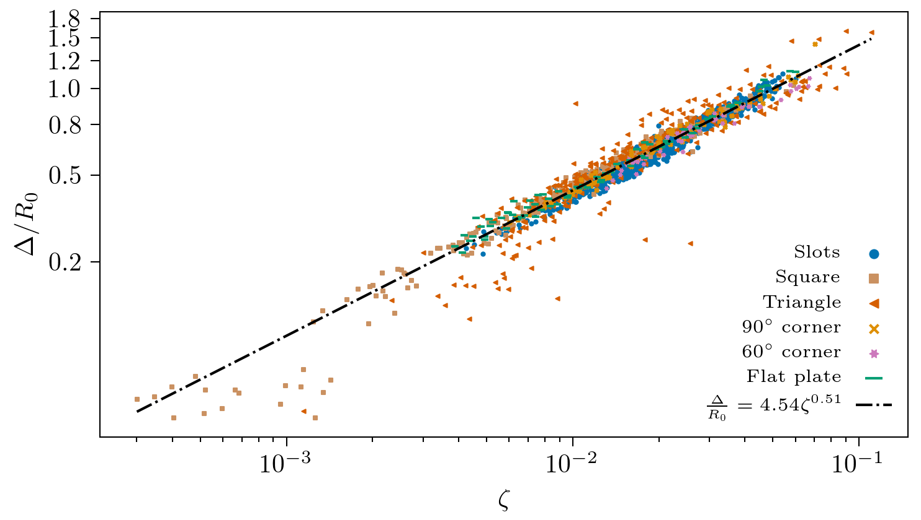
Summary
Bubbles in very different geometries can behave similarly
A simple model reduces the geometric conditions to a single parameter
This model causes bubble displacement data for all geometries to collapse
e.d.andrews@soton.ac.uk

