Slide 1
Controlling Cavity Topology Relationship between erosivity and cavity topology on modified NACA series hydrofoil
Elijah Andrews, Danny Corrada, Harish Ganesh, Steve Ceccio
University of Michigan

Slide 2
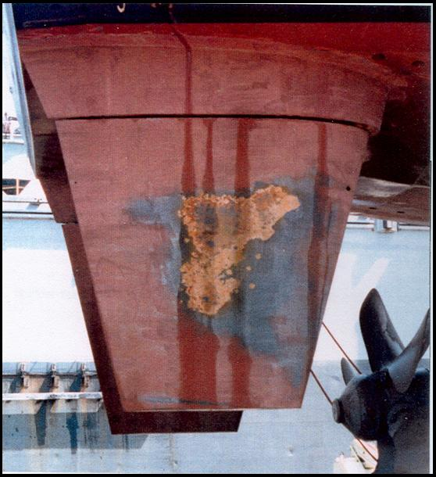
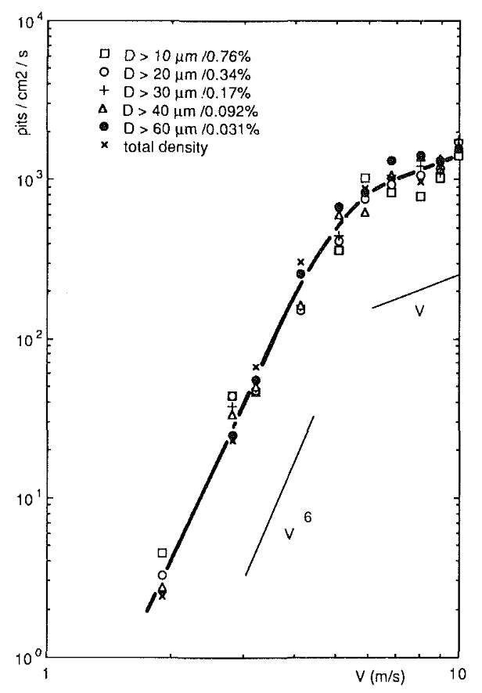
Cavitation erosion – what do we know?
Shen, Y. T., Remmers, K. D., & Jiang, C. W. (1997) Journal of Ship Research, 41(03), 172–180.
Belahadji, B., Franc, J. P., & Michel, J. M. (1991) Journal of Fluids Engineering, 113(4), 700–706.
Notes:
30 seconds – quick background?

Slide 3
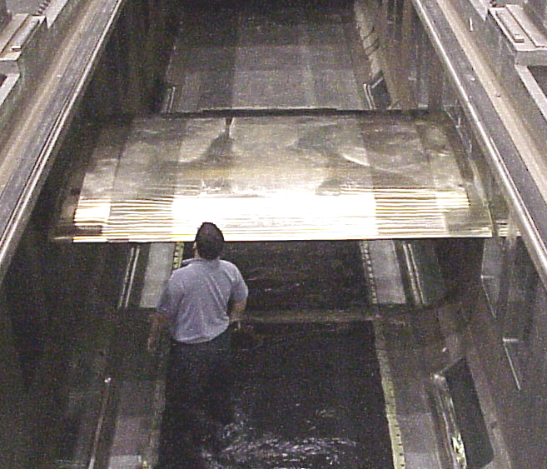
Large scale erosion study
The objective: Study erosion at ‘full-scale’.
3 meter span!
Reynolds numbers $\sim$50 million
Notes:
1m30 seconds – detailed motivation
Research is generally conducted on small scales
So how would large scale affect erosion?
But to do this effectively, we need to control the cavity topology

Slide 4
Cavity topology can be challenging
Non-uniform cavitation along the leading edge
Notes:
1 minute – highlight challenges?

Slide 5
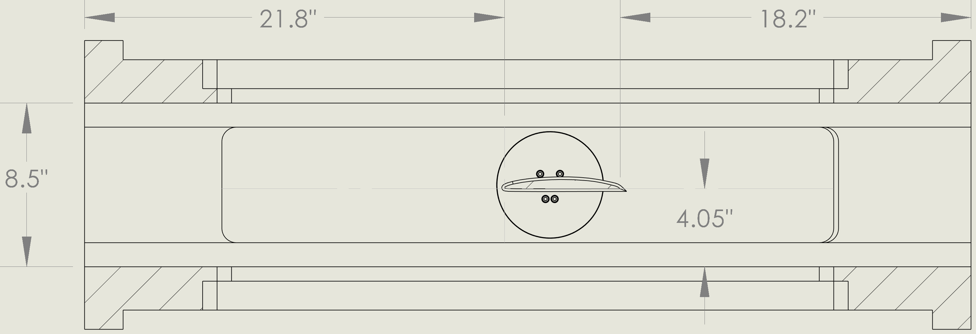
Experimental setup
Flow
Mirror
Running the tunnel at 8 m/s and 10 m/s yields chord-based Re ~1.2 and 1.5 million.
Primary camera (Phantom v1212)

Slide 6
Measurement conventions
Flow
-ve $α$
+ve lift direction
+ve drag direction
+ve moment direction
$$σ=\frac{(p_{0}−p_{v})}{\frac{1}{2}ρU_{0}^{2}}$$
$p_{0}$ is upstream pressure
$p_{v}$ is vapour pressure
$U_{0}$ is upstream velocity
$ρ$ is fluid density
Cavitation number:

Slide 7
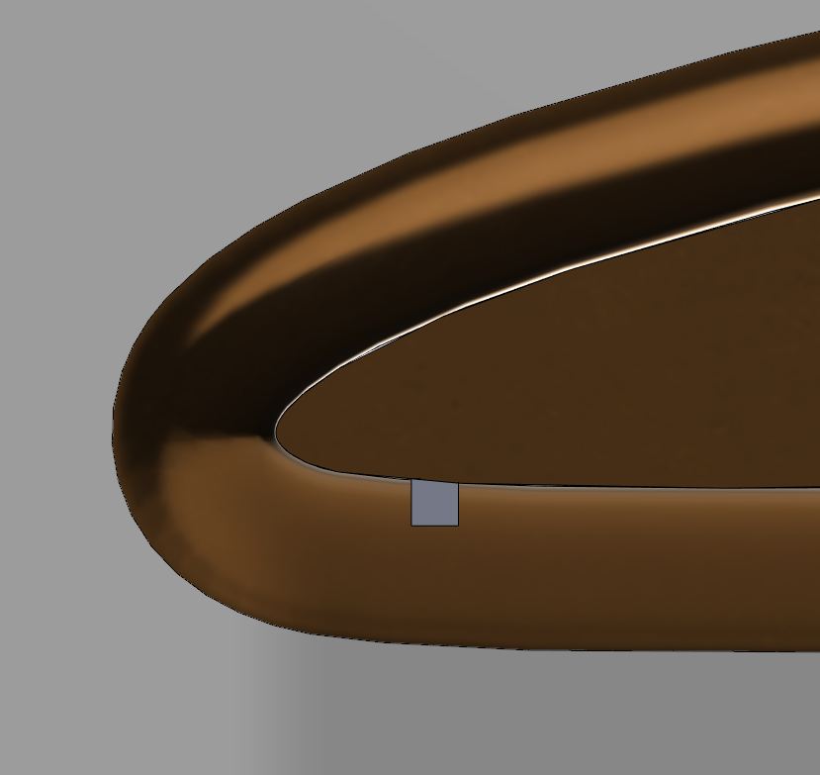
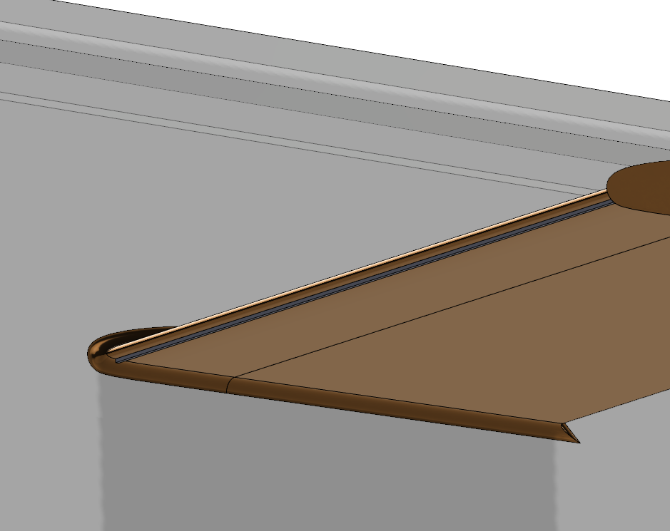
Adding a fence to cause cavitation
Fence installed in a a machined groove on the foil surface at X/C ~ 0.01 (O(1 mm))

Slide 8
Measuring cavity length
Fence
1000 fps (not synced)
$$α=−2.5±{0.1}^{∘}$$
$$σ=0.45±0.01$$
$$L_{C}/c=0.54±0.03$$
3000 frames per second

Slide 9
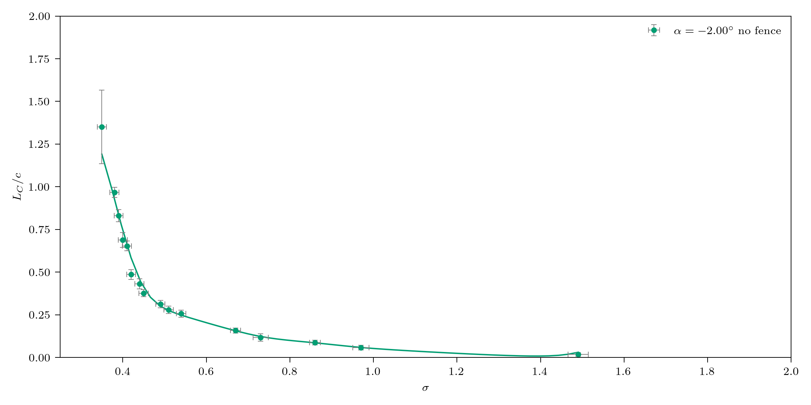
Measuring cavity length

Slide 10
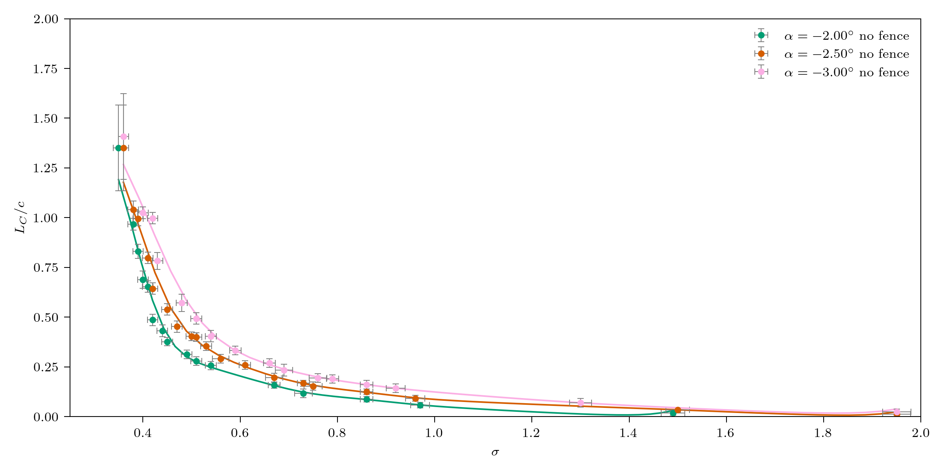
Measuring cavity length

Slide 11
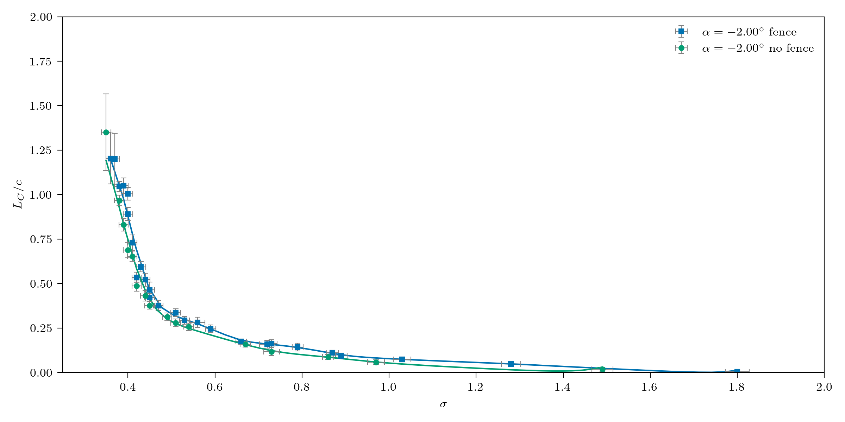
Fence increases cavity length

Slide 12
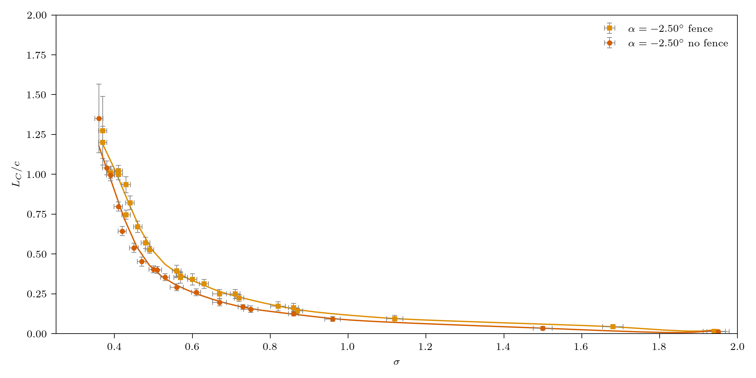
Fence increases cavity length

Slide 13
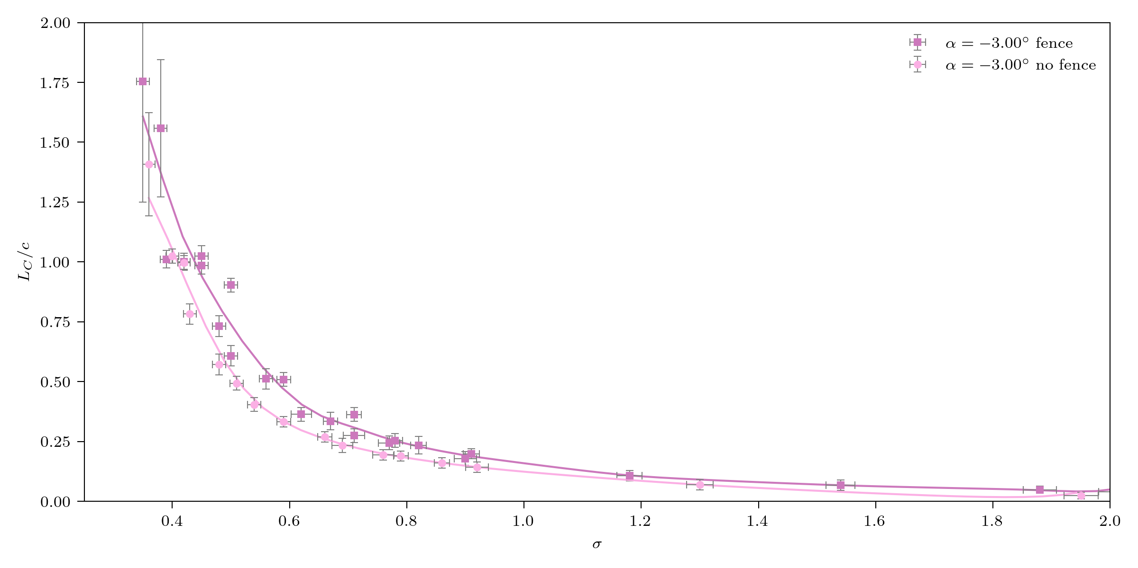
Fence increases cavity length

Slide 14
Effect on cavity consistency
No fence ($σ=0.73$)
$$L_{C}/c=0.16$$
Fence ($σ=0.84$)

Slide 15
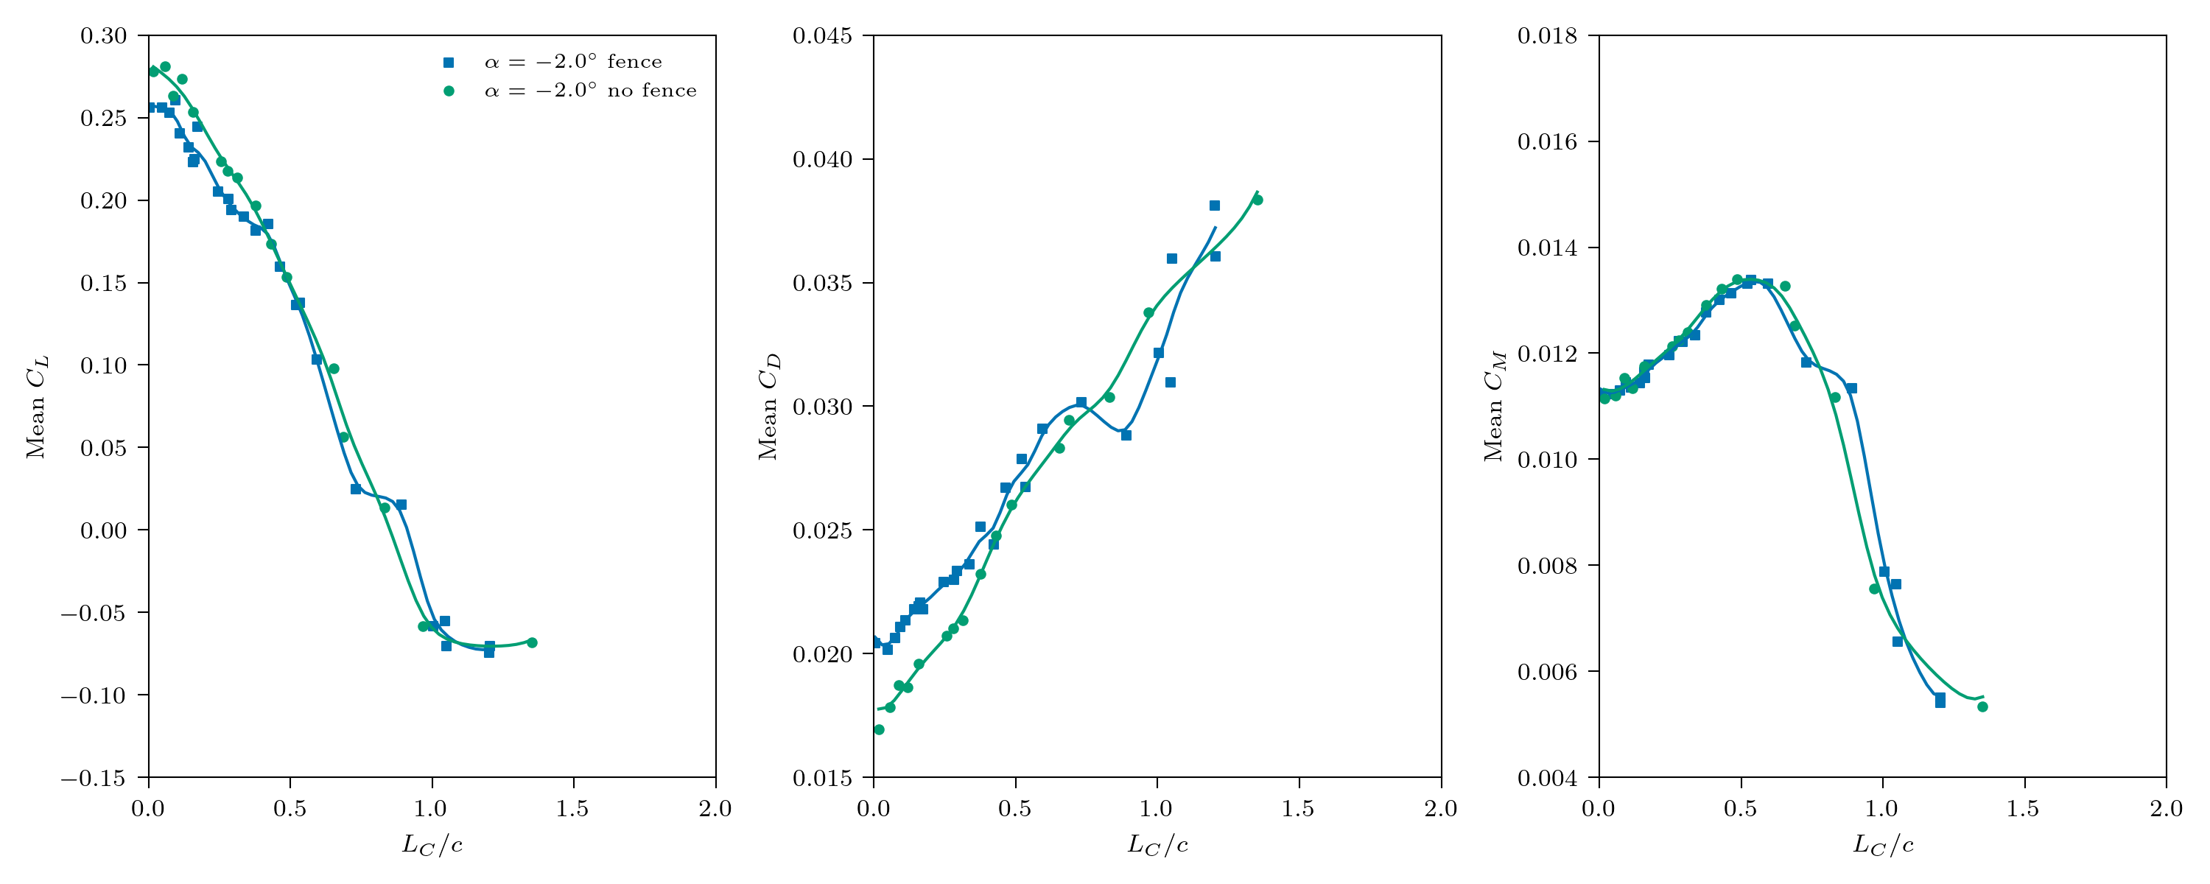
Effect on hydrofoil loading – Mean forces
Lift
Drag
Half-chord moment

Slide 16
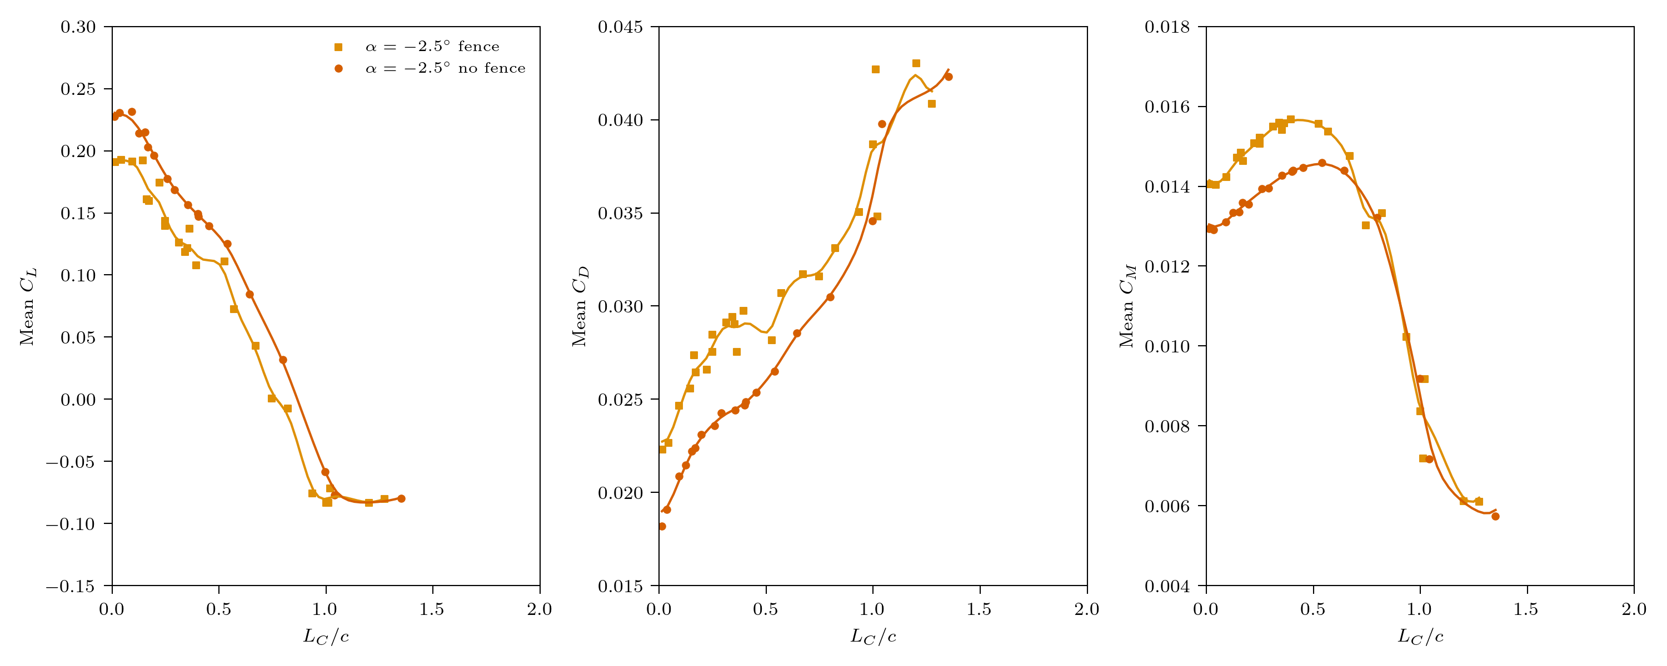
Effect on hydrofoil loading – Mean forces
Lift
Drag
Half-chord moment

Slide 17
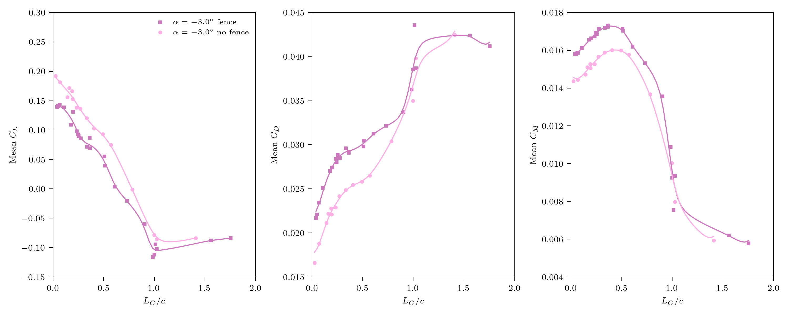
Effect on hydrofoil loading – Mean forces
Lift
Drag
Half-chord moment

Slide 18
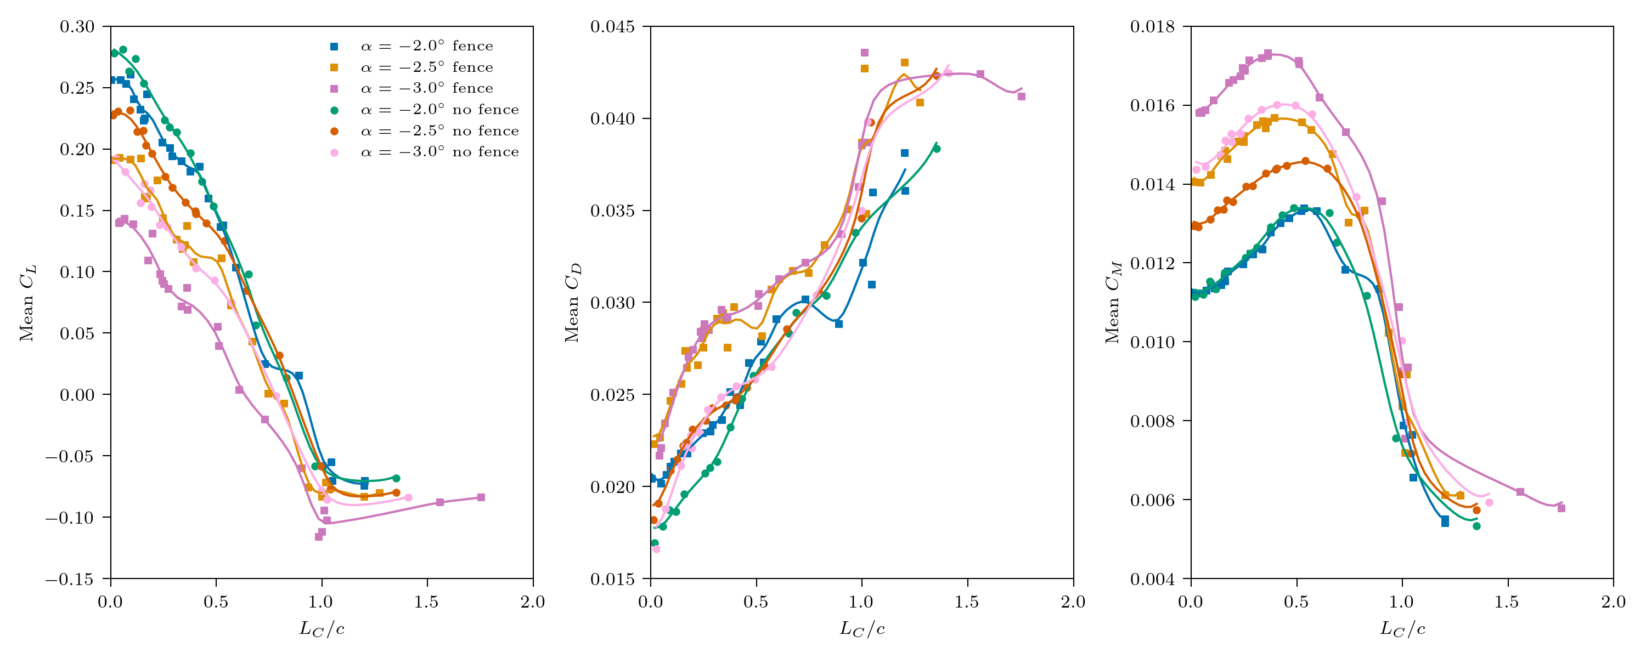
Effect on hydrofoil loading – Mean forces
Lift
Drag
Half-chord moment

Slide 19
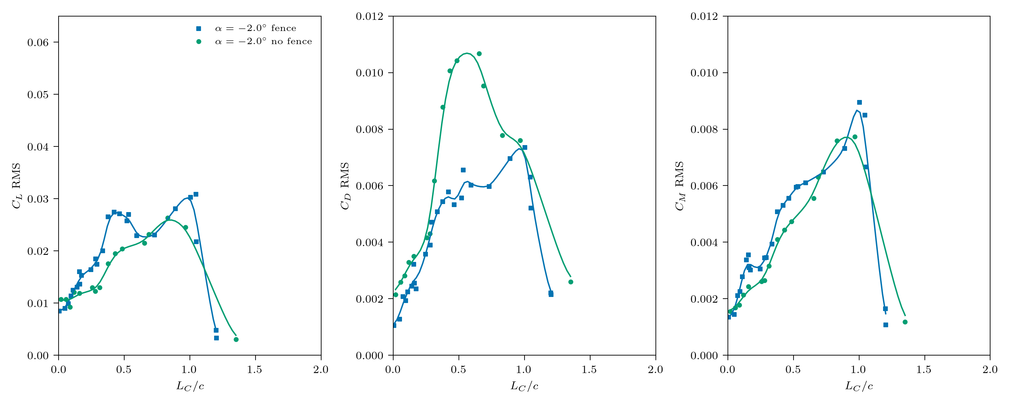
Effect on hydrofoil loading - fluctuations
Lift
Drag
Half-chord moment

Slide 20
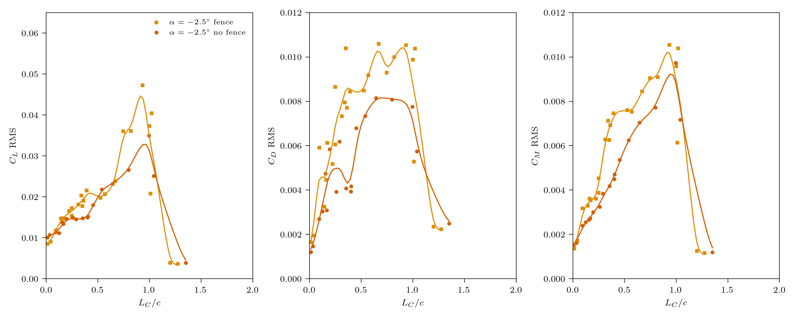
Effect on hydrofoil loading - fluctuations
Lift
Drag
Half-chord moment

Slide 21
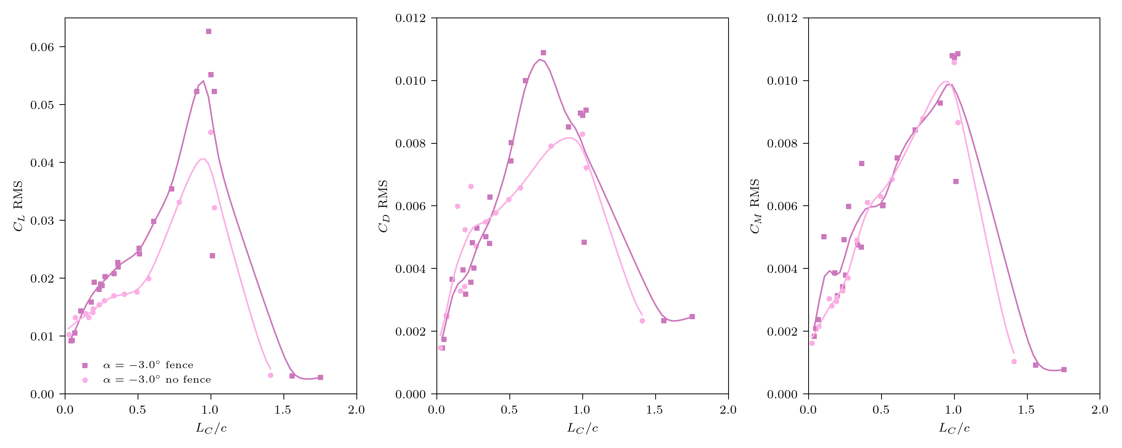
Effect on hydrofoil loading - fluctuations
Lift
Drag
Half-chord moment

Slide 22
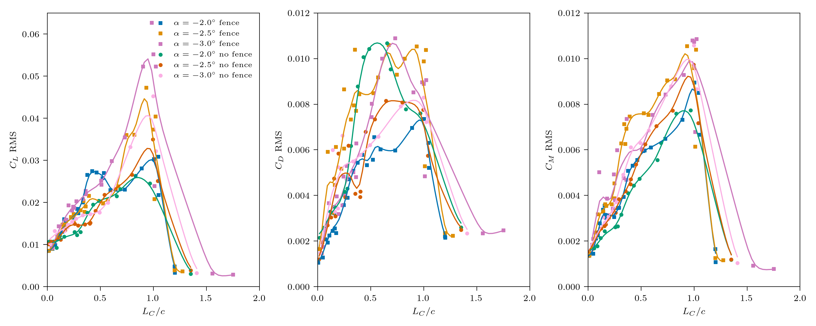
Effect on hydrofoil loading - fluctuations
Lift
Drag
Half-chord moment

Slide 23
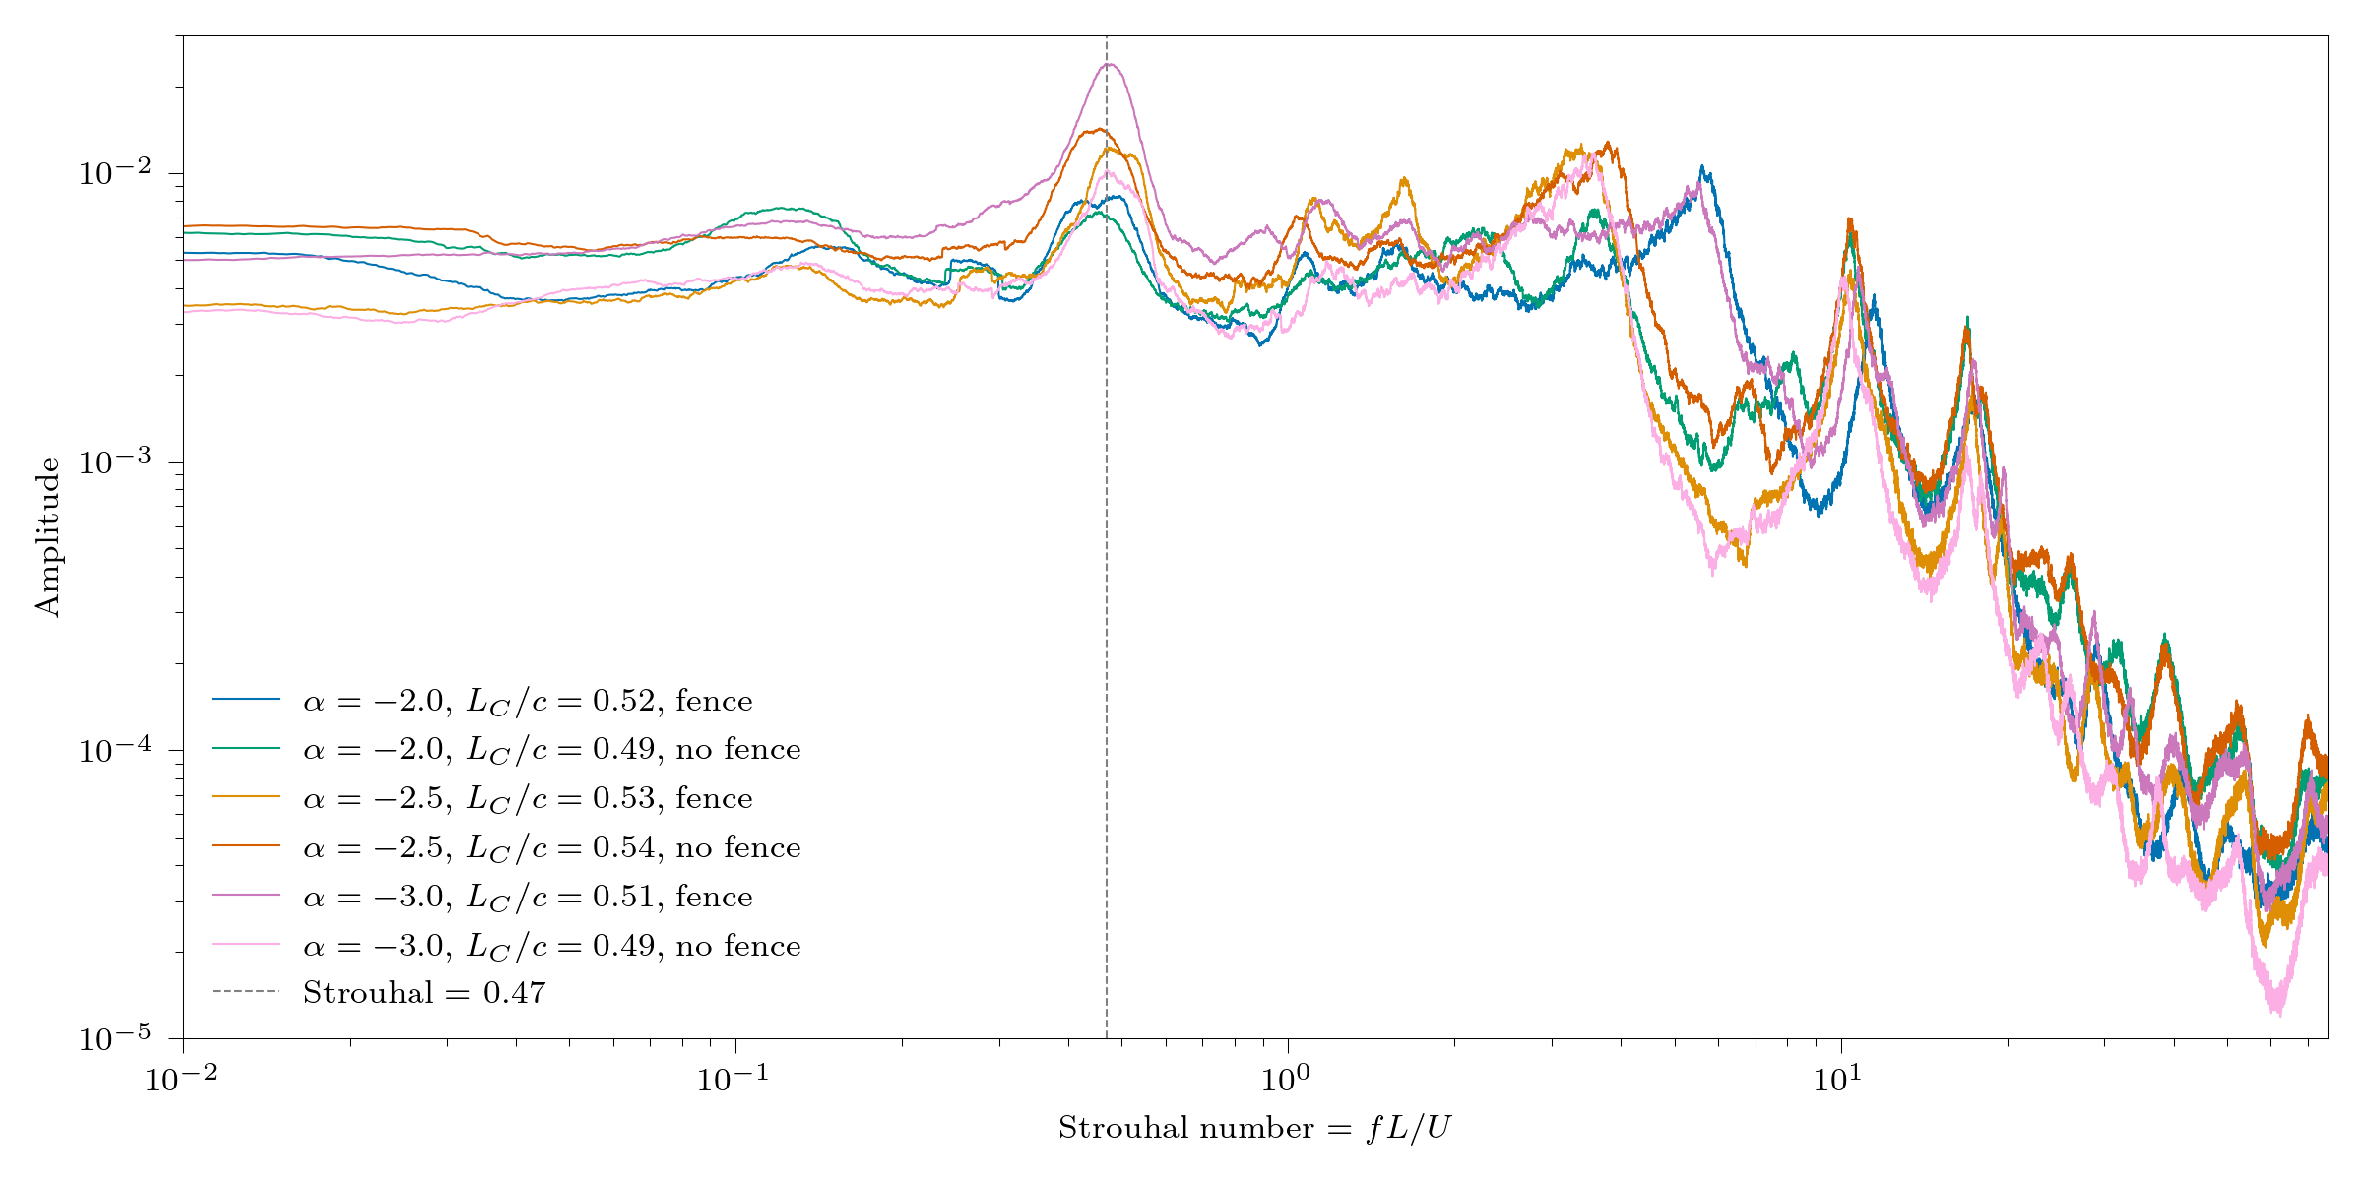
Effect on hydrofoil loading - frequencies

Slide 24
Summary
Erosion experiments can be challenging
A fence can be used to improve cavitation topology
The fence has no significant effect on cavitation loading
Large scale erosion experiments set to begin in July!

