Slide 1
Characterizing cavitating flow over a hydrofoil using X-ray densitometry
Elijah Andrews, Nick Lucido, Harish Ganesh, Steve Ceccio
University of Michigan
APS DFD 2024 – Salt Lake City

Slide 2
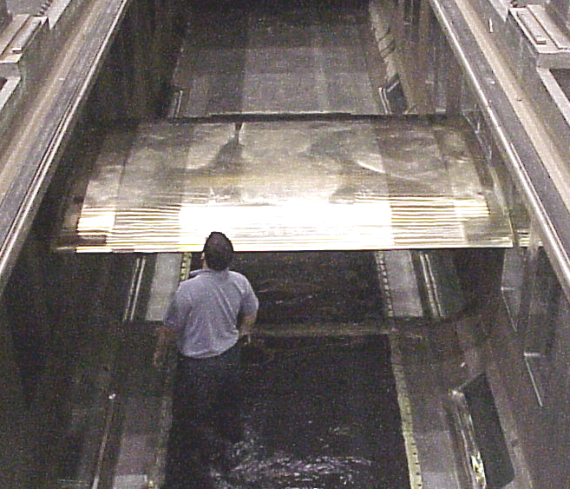
Large-scale erosion study
Reynolds numbers $\sim$50 million
The objectives:
Study erosion at ‘full-scale’
Measure hydrodynamics
Compare between scales
3 meter span!

Slide 3
HIFOIL cavitating
🔍,NSWC Carderock Cavitation Erosion

Slide 4
Cavitating hydrofoil
Flow
Cavity
-ve $α$
Lower $σ$ → more cavitation
$$σ=\frac{(p_{0}−p_{v})}{\frac{1}{2}ρU_{0}^{2}}$$
$p_{0}$ is upstream pressure
$p_{v}$ is vapour pressure
$U_{0}$ is upstream velocity
$ρ$ is fluid density
Cavitation number:

Slide 5
Cavitating hydrofoil
Flow
Cavity
-ve $α$
Lower $σ$ → more cavitation
$$σ=\frac{(p_{0}−p_{v})}{\frac{1}{2}ρU_{0}^{2}}$$
$p_{0}$ is upstream pressure
$p_{v}$ is vapour pressure
$U_{0}$ is upstream velocity
$ρ$ is fluid density
Cavitation number:

Slide 6
Cavitating hydrofoil
Flow
Cavity
-ve $α$
Lower $σ$ → more cavitation
$$σ=\frac{(p_{0}−p_{v})}{\frac{1}{2}ρU_{0}^{2}}$$
$p_{0}$ is upstream pressure
$p_{v}$ is vapour pressure
$U_{0}$ is upstream velocity
$ρ$ is fluid density
Cavitation number:

Slide 7
Cavitating hydrofoil
Flow
Cavity
-ve $α$
Lower $σ$ → more cavitation
$$σ=\frac{(p_{0}−p_{v})}{\frac{1}{2}ρU_{0}^{2}}$$
$p_{0}$ is upstream pressure
$p_{v}$ is vapour pressure
$U_{0}$ is upstream velocity
$ρ$ is fluid density
Cavitation number:

Slide 8
Cavitating hydrofoil
Flow
Cavity
-ve $α$
Lower $σ$ → more cavitation
$$σ=\frac{(p_{0}−p_{v})}{\frac{1}{2}ρU_{0}^{2}}$$
$p_{0}$ is upstream pressure
$p_{v}$ is vapour pressure
$U_{0}$ is upstream velocity
$ρ$ is fluid density
Cavitation number:

Slide 9
Cavities shed by two mechanisms
Re-entrant jets
Bubbly shock waves
Using our old detector
Bhatt, A., Ganesh, H., & Ceccio, S. L. (2023). Partial cavity shedding on a hydrofoil resulting from re-entrant flow and bubbly shock waves. Journal of Fluid Mechanics, 957, A28.
Notes:
Classic re-entrant jet
Bubbly shocks
Probability of each varies with cavity Mach number

Slide 10
Mechanism probability depends on Mach number
Re-entrant jets
M
P
Bubbly shock waves
Shocks + Cavitation at TE
Shocks dominant
Re-entrant+
Shocks
Oscillatory Cavity
$$σ/2α$$
Mach number $M=\frac{u_{0}}{c}$
$$\frac{1}{{ρ_{m}c}^{2}}=\frac{β}{p}g_{V}+\frac{1−β}{p^{1+η}}g^{∗}p_{cr}^{η}$$
Bhatt, A., Ganesh, H., & Ceccio, S. L. (2023). Partial cavity shedding on a hydrofoil resulting from re-entrant flow and bubbly shock waves. Journal of Fluid Mechanics, 957, A28.
Notes:
Classic re-entrant jet
Bubbly shocks
Probability of each varies with cavity Mach number

Slide 11
X-ray densitometry of HIFOIL
#703
Flow
Dectris Eiger2 X CdTe 1M-W
Photon-counting detector
2068 x 512 pixels
High speed (1000 Hz typical)
Void fraction colours (higher % is more vapour)
From Beer-Lambert: Void fraction $=\ln\left(\frac{I_{m}}{I_{w}}\right)/\ln\left(\frac{I_{a}}{I_{w}}\right)$

Slide 12
Shedding from bubbly shocks
Synchronised high-speed optical and X-ray imaging
$p_{0}=22.9±0.5$ kPa
$U_{0}=10.0±0.1$ m/s
$$α=−2±{0.1}^{∘}$$
$$σ=0.40±0.01$$
Recorded at 1000 fps
Played back at 15 fps
#703

Slide 13
Shedding from bubbly shocks
#703
$p_{0}=22.9±0.5$ kPa
$U_{0}=10.0±0.1$ m/s
$$α=−2±{0.1}^{∘}$$
$$σ=0.40±0.01$$
Side view – 1000 fps
Void fraction colours (higher % is more vapour)

Slide 14
Bubbly shock structure

Slide 15
Shedding from bubbly shocks
#703
$p_{0}=22.9±0.5$ kPa
$U_{0}=10.0±0.1$ m/s
$$α=−2±{0.1}^{∘}$$
$$σ=0.40±0.01$$
Side view – 1000 fps
Void fraction colours (higher % is more vapour)

Slide 16
Shedding from re-entrant jets
Synchronised high-speed optical and X-ray imaging
$p_{0}=20.5±0.5$ kPa
$U_{0}=10.0±0.1$ m/s
$$α=−2±{0.1}^{∘}$$
$$σ=0.35±0.01$$
Recorded at 1000 fps
Played back at 15 fps
#695

Slide 17
Shedding from re-entrant jets
#695
$p_{0}=20.5±0.5$ kPa
$U_{0}=10.0±0.1$ m/s
$$α=−2±{0.1}^{∘}$$
$$σ=0.35±0.01$$
Side view – 1000 fps
Void fraction colours (higher % is more vapour)

Slide 18
Fluid layer inside supercavity
Synchronised high-speed optical and X-ray imaging
$p_{0}=19.2±0.5$ kPa
$U_{0}=10.0±0.1$ m/s
$$α=−2±{0.1}^{∘}$$
$$σ=0.32±0.01$$
Recorded at 1000 fps
Played back at 15 fps
#696

Slide 19
Fluid layer inside supercavity
#696
$p_{0}=19.2±0.5$ kPa
$U_{0}=10.0±0.1$ m/s
$$α=−2±{0.1}^{∘}$$
$$σ=0.32±0.01$$
Side view – 1000 fps
Void fraction colours (higher % is more vapour)

Slide 20
Summary and upcoming work
In this presentation:
Motivated cross-scale comparison
Demonstrated small-scale void fraction measurements
Characterised interesting dynamics using X-ray densitometry
Upcoming work:
Detailed cavity measurements at small scale (e.g. cavity pressure)
Use electrodes to measure cavity void fraction at full scale
Compare dynamics between scales
Thank you!
elijahan@umich.edu

Slide 21
X-ray densitometry can measure void fraction
Intensity $I$ measured by photon-counting detector
$$I_{0}$$
$$I_{w}$$
Measure $I_{w}$, $I_{a}$ for calibration
Measure $I_{m}$ from cavity
Apply Beer-Lambert law
Water
$$I_{0}$$
$$I_{a}$$
Air
From Beer-Lambert law:
$$I_{0}$$
$$I_{m}$$
Void fraction $α=\ln\left(\frac{I_{m}}{I_{w}}\right)/\ln\left(\frac{I_{a}}{I_{w}}\right)$
Air/water mixture
Mäkiharju et al. (2013) Experiments in Fluids, 54(7), 1–21.
Notes:
The void fraction is important to understand the internal characteristics of the cavity. Particularly, from understanding the Mach number in the cavity.

Slide 22
Small-scale optical high-speed imaging shows dynamics
Back view - 1000 fps (not synced)
$p_{0}=20.9±0.5$ kPa
$U_{0}=10.0±0.1$ m/s
$\frac{L_{C}}{c}=0.81±0.04$
$$σ=0.36±0.01$$
$$α=−2±{0.1}^{∘}$$
Flat surface view - 3000 fps

